Slide 1
ECE1508H Final Project Presentation
Text Translation using YouTube Video Transcripts
Group 33 MEMBERS: Jiaxiang E
Henry Ye, Shuqi Yang

Slide 2
Agenda
Data Extraction and Semantic Alignment
YouTube Transcripts (Data extraction + Data preprocessing)
Word2Vec and Word Embeddings(vecmap)
Deep Learning Models
Recurrent Neurnal Networks(RNNs)
Vanilla, GRU, LSTM, Transformer, Seq2Seq Architectures
Results Analysis and Discussion
NLP Bilingual Evaluation: BLEU, METEOR, Cosine Similarity
Existing Result: Seq2Seq LSTM with 0.8 BLEU score & 0.85 Cosine Similarity
Limitations & Future Works

Slide 3

Data Extraction:Why we choose documentaries?
YouTube transcript API

Slide 4
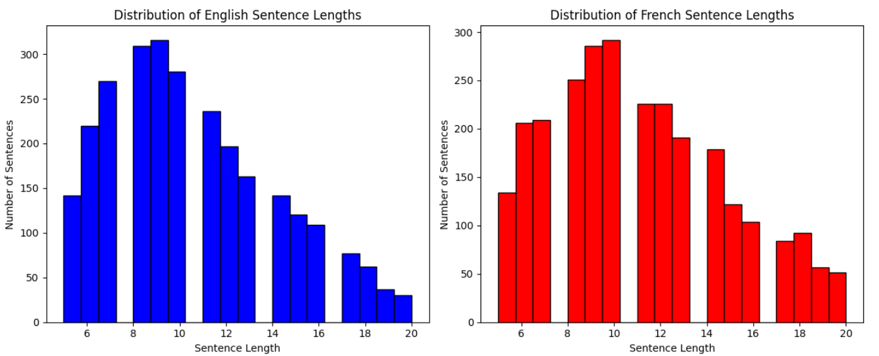
Data Preprocessing

Slide 5
Data Preprocessing Result
2168 Pairs of Samples Split into train(80%), valid(10%) and test(10%) sets.
English Vocabulary Size: 4334
French Vocabulary Size: 5051
Example First English Sentence:
When the winter world disappears, and the sun’s rays begin…
Tokens: [1, 867, 1199, 3, 1200, 8, 27, 1926, 5, 869, 1927, 2, 0, 0, 0, 0] (padding)
Corresponding First French Translation:
Quand le monde hivernal disparaît et que les rayons du soleil commencent…
Tokens: [1, 15, 687, 8, 1225, 6, 855, 2028, 140, 4, 45, 2029, 9, 2030, 2031, 2]

Slide 6
Word2vec & Vacmap
Word2vec：
Embeddings：Converts a word to a set of numeric values
Vecmap：
Cross-lingual word embedding mappings
Map to a shared space

Slide 7
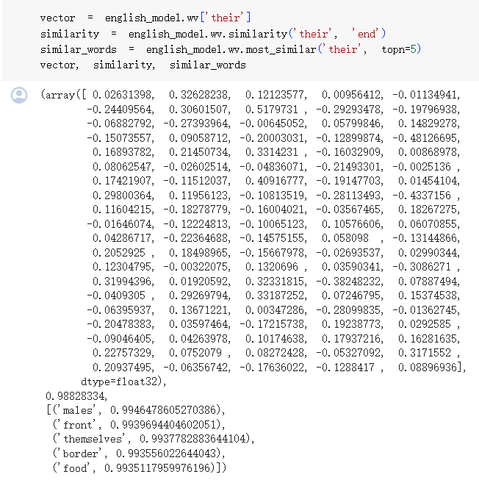
Sample output of word2vec vector for "their" with its most frequent occur words

Slide 8
General Model Setup
Device: Cuda
Loss: Negative Log Likelihood Loss (NLLLoss)
Optimizer: AdamW
Learning rate: 0.005 for stand-alone models, 0.001 for Seq2Seq models
Embedding Dimension Size: 256
Hidden Size: 256

Slide 9
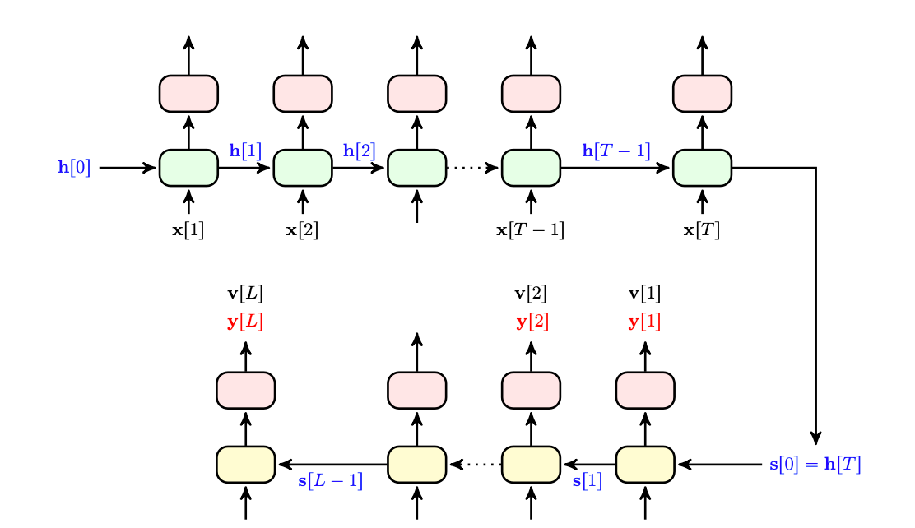
Recurrent Neural Network (RNN) Architecture
Vanilla
LSTM
GRU
Seq2Seq

Slide 10
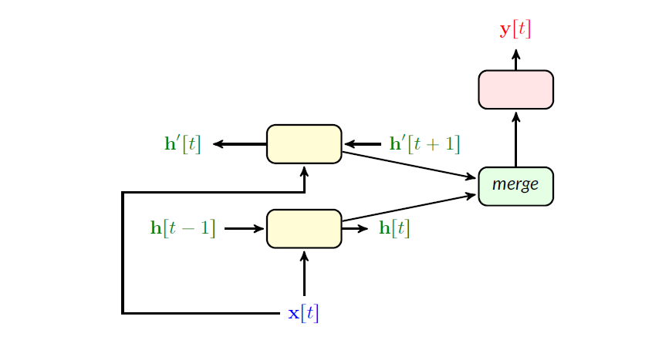
Birdictional Model

Slide 11
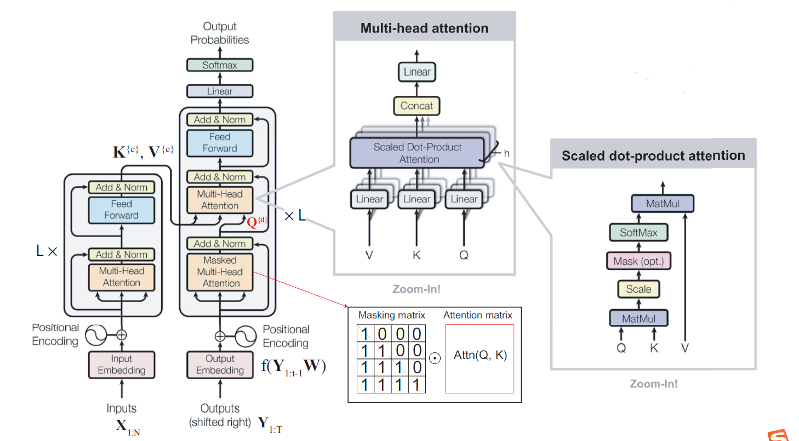
Transformer Architecture

Slide 12
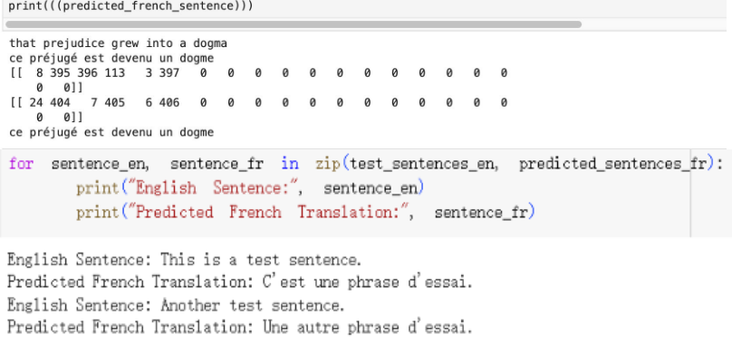
Sample Translation Output of Transformer

Slide 13
Evaluating NLP-Translation Quality
Bilingual Evaluation Understudy (BLEU)
Calculated by comparing the hypothesis to a reference translation, without taking into account grammatical correctness.
Output a number between 0 and 1, indicating how similar the candidate text is to the reference text, with values closer to 1 indicating more similar texts.
Metric for Evaluation of Translation with Explicit Ordering (METEOR)
Addressing limitations inherent in BLEU scores.
Different words from the reference - as long as they have the same meaning.
Consider logically and grammatically sound structures.
Cosine Similarity
Words are assigned a coordinate, and the document is measured by a vector representation of the number of occurrences of each word.
Measure of similarity between two non-zero vectors (how similar two documents are in terms of topic)

Slide 14
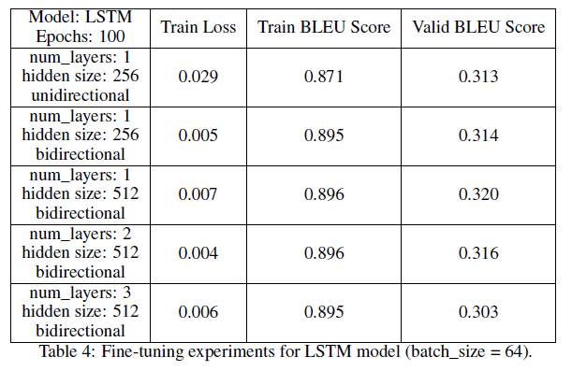
Fine-Tuning Experiment with LSTM:
Batch Size = 64

Slide 15
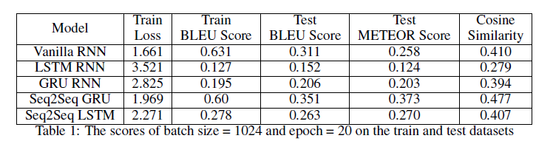
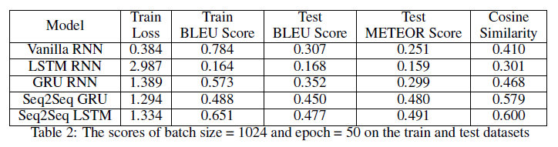
Fine-Tuning Experiments With Models
Epochs Up!

Slide 16
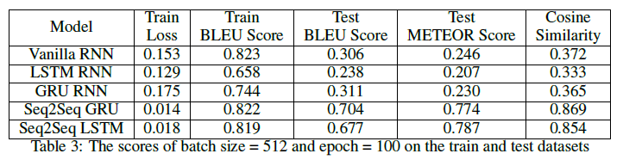
Downsize Batch Size!

Slide 17
Experiment Results Analysis
Experiment Findings:
LSTM models showed the highest training loss, whereas Vanilla RNN had the lowest.
Seq2seq GRU achieved the best results in test BLEU, METEOR scores, and cosine similarity.
Results:
With a batch size of 1024 and 20 epochs and batch size of 512 and 100 epochs, GRU seq2seq models performed best.
With a batch size of 1024 and 50 epochs, LSTM seq2seq models performed best.
Standalone LSTM models performed worst in test score comparisons.
LSTM models require the seq2seq framework for effective long-term memory utilization.
Final Experiment Outcome:
Seq2Seq GRU excelled in BLEU and cosine similarity with batch size of 512 & 100 epochs.
Seq2Seq LSTM was a close second, achieving the highest METEOR score, but standalone LSTM performed worst.
Seq2seq models (LSTM or GRU) outperform simple RNNs, and pure GRU models consistently surpass pure LSTM models across all metrics.

Slide 18
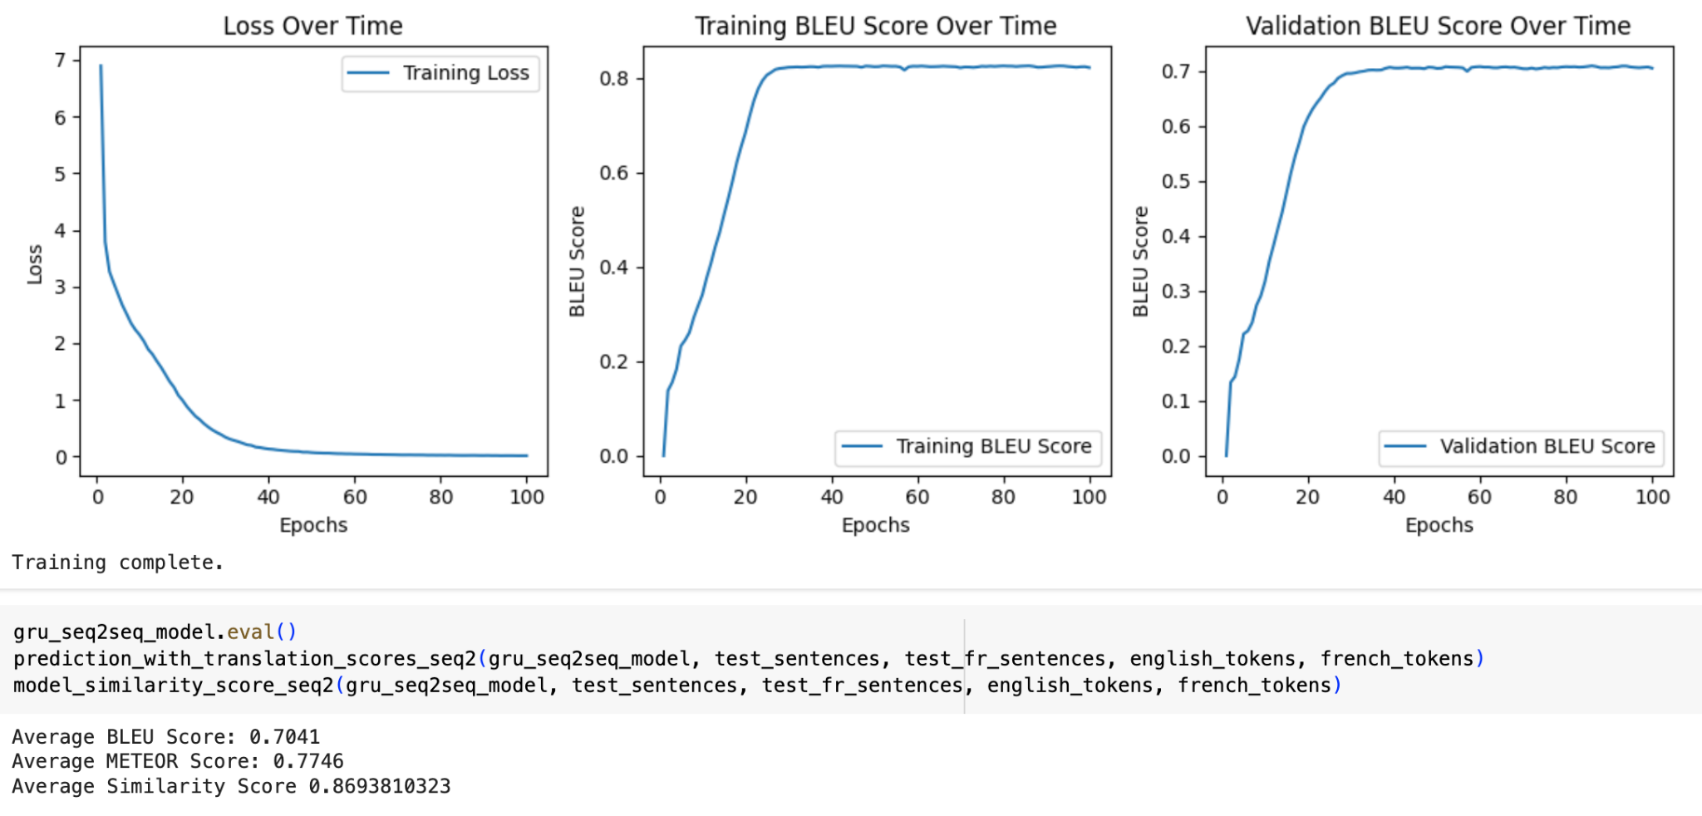
Best Model: Seq2Seq GRU with Training Curve

Slide 19
Discussion
Model Performance: Low training losses, high training BLEU scores indicate robust architecture but validation/testing BLEU scores plateau, generalization issues.
Primary Causes: Insufficient data, inadequate data processing due to limited vocabulary size (~5,000 words), and highly skewed word frequency distribution from a corpus of ~2,600 sentences.
Solutions:
Augment dataset with a wider range of bilingual subtitles.
Implement subword tokenization methods like Byte Pair Encoding (BPE).
Incorporate pre-trained embeddings (fastText, BERT).
Explore new regularization methods (weight decay, label smoothing).
Utilize advanced strategies like ensemble methods, data augmentation (back-translation, paraphrase), and beam search during inference.

Slide 20
Future Expectation
Expand dataset and refine preprocessing.
Explore cutting-edge models and techniques, including:
Model merging strategies (SWA, EMA).
Accelerated inference options (Mixed Precision, quantization).
Defense against Adversarial Attacks (AWP).
Advanced pre-trained models (DeBERTa v3).

Slide 21
Q&A
Thank you for your listening! :)

Slide 22
References
[1] S. Hochreiter and J. Schmidhuber, "Long short-term memory," Neural Computation, vol. 9, no. 8, pp. 1735-1780, 1997. [Online]. Available: https://doi.org/10.1162/neco.1997.9.8.1735
[2] I. Sutskever, O. Vinyals, and Q. V. Le, "Sequence to sequence learning with neural networks," in Advances in Neural Information Processing Systems, 2014, pp. 3104-3112. [Online]. Available: http://papers.nips.cc/paper/5346-sequence-to-sequence-learning-with-neural-networks.pdf
[3] A. Vaswani et al., "Attention is all you need," in Advances in Neural Information Processing Systems, 2017, pp. 5998-6008. [Online]. Available: http://papers.nips.cc/paper/7181-attention-is-all-you-need.pdf

Slide 23
References
[4] Marian-NMT, "Marian: Fast Neural Machine Translation in C++," GitHub repository, [Online]. Available: https://github.com/marian-nmt/marian, Accessed on: Apr. 4, 2024.
[5] A. Vaswani et al., "Attention is all you need," Advances in Neural Information Processing Systems, vol. 30, 2017. [Online]. Available: http://papers.nips.cc/paper/7181-attention-is-all-you-need.pdf

